Slide 1


Weather Prediction Using Machine Learning Models
Location: Wolverhampton, Uk.
Buzugbe Uchechukwu Ephraim
2329926

Slide 2

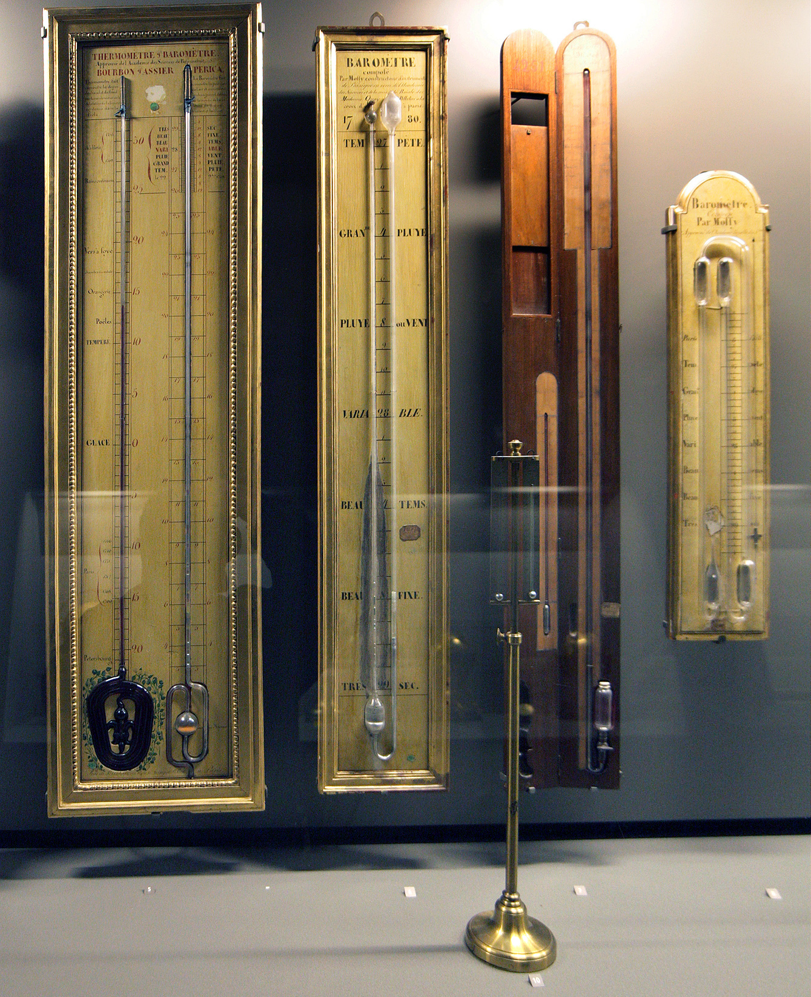
Background Study
Ancient Methods
Early weather predictions were based on patterns observed by farmers and sailors.
Ancient civilizations used natural indicators like animal behavior, sky color, and cloud formations.
Scientific Advancements
Thermometers: Measure air temperature.
Barometers: Measure atmospheric pressure.
Anemometers: Measure wind speed.
Hygrometers: Measure humidity.

Slide 3
Background Study
Advanced Machine learning Techniques
Machine learning (ML) techniques were introduced in the late 20th century as computational power increased.
Early models focused on statistical methods like linear regression and basic classification algorithms.

Slide 4
Overview of the Project
The project aims to utilize machine learning algorithms to predict weather conditions, focusing specifically on temperature forecasting.
Multiple regression models were evaluated to determine their effectiveness in accurately predicting weather.
The study involved collecting historical weather data, preprocessing the data, training various models, and evaluating their performance using standard error metrics.

Slide 5
Objective
To find out the effectiveness of machine learning models in predicting daily weather conditions in Wolverhampton, United Kingdom.
To evaluate which machine learning algorithm will provide the best accuracy for weather predictions in Wolverhampton, United Kingdom.
To compare the prediction accuracy of machine learning models for Wolverhampton's weather compared with on ground temperature.

Slide 6

Data Collection
The data used for this study was sourced from the Visual Crossing Weather Data. It is a global weather database for historical and forecast weather data and climate summaries that can be used by data scientists, meteorologists and other professionals in forecasting weather conditions (Visual Crossing, 2024). The Wolverhampton Weather data was retrieved from this database and the data was taken over a 24-year period (01/01/2000 – 16/04/2024).

Slide 7
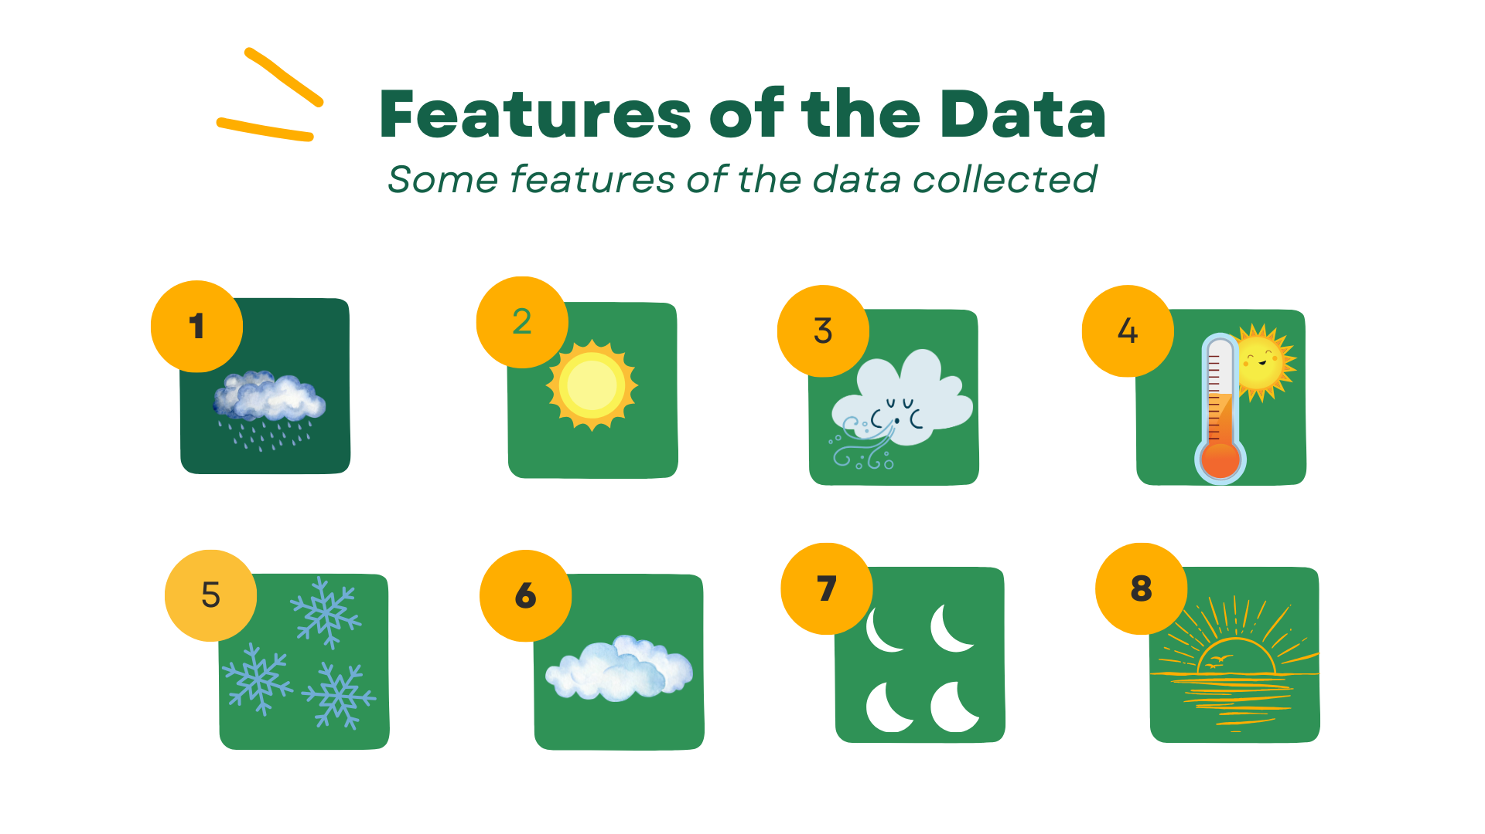
Data Collection
Rainfall
Sunshine
Wind and Wind gust
Temperature
Snow and snow depth
Cloud cover
Moon phase
Sunset and Sunrise

Slide 8
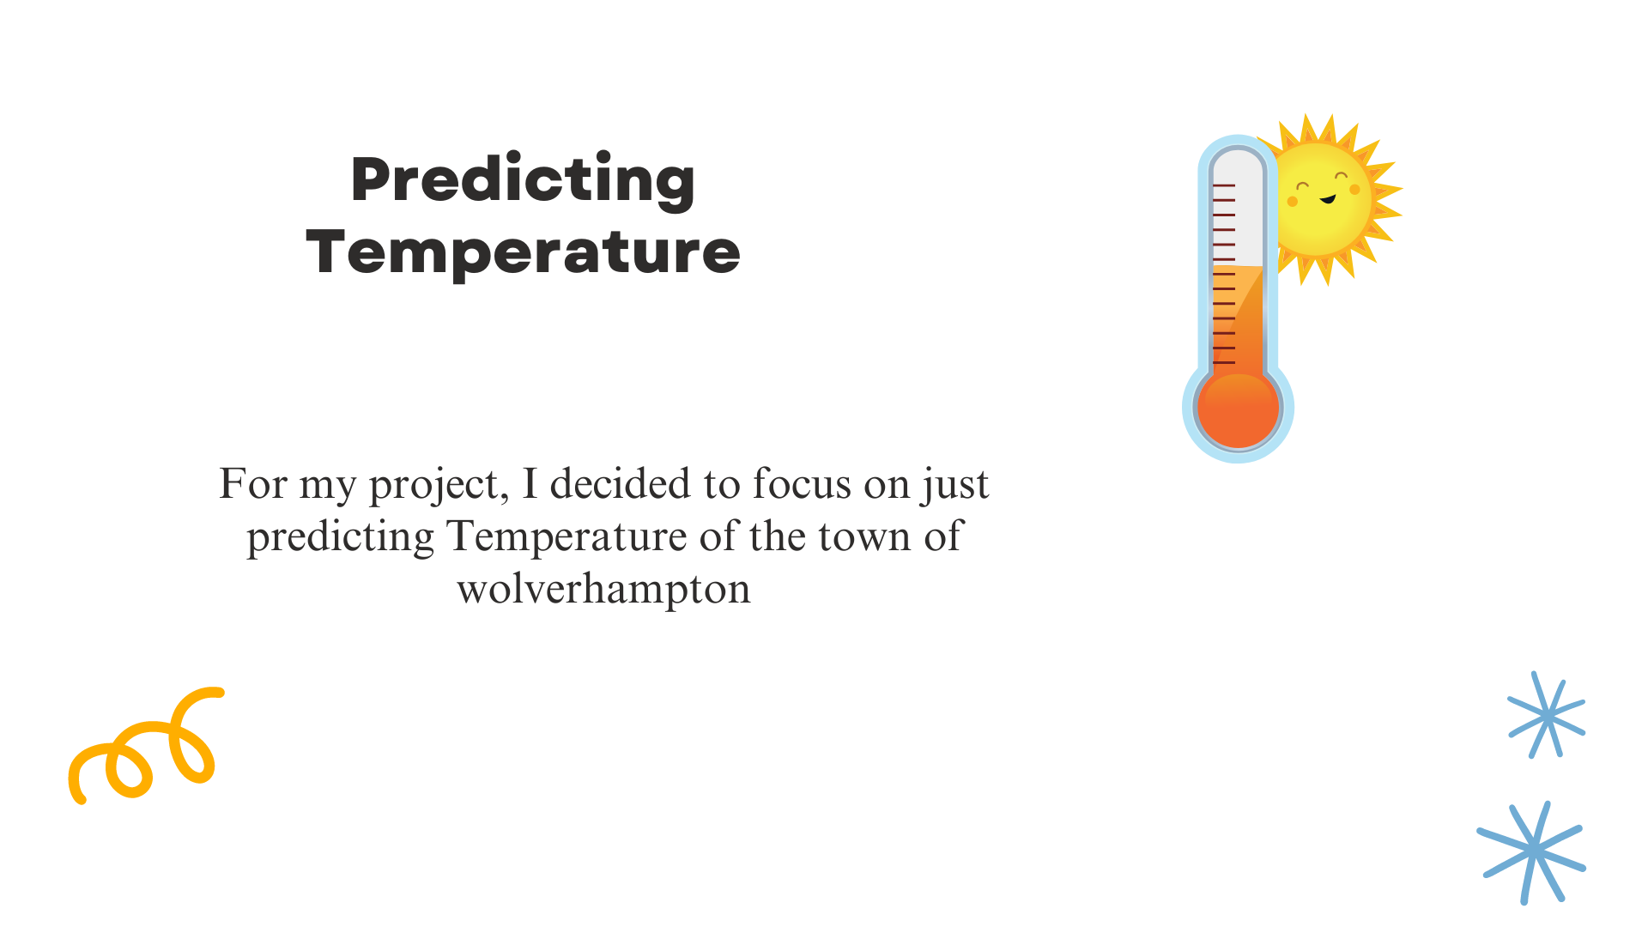

Slide 9

Data Merging/Cleaning
Data Merging
The 24 individual datasets were merged as one
Data Cleaning
Imputation: Applied techniques such as mean, median, or mode imputation to handle missing data points.
Interpolation: Used linear interpolation to estimate missing values in the time series data.

Slide 10
Pre-Processing Data
Date Features: Extracted features such as day of the year, month, and day of the week from the date.
Rolling Average: Computed rolling means and standard deviations to capture trends and variability.
Normalization: Scaled features to a standard range (e.g, 0 to 1) to ensure uniformity across the dataset.
Standardization: Applied z-score standardization to normalize the data distribution.
Training and Testing Split: Divided the data into training and testing sets to evaluate model performance.

Slide 11
Models Evaluated
Linear Regression
Rigid Regression
ARIMA
Random Forest
Decision Tree

Slide 12
Error Metric Used
Mean Absolute Error (MAE)
Mean Squared Error (MSE)
Root Mean Squared Error (RMSE)
R-squared (R2)

Slide 13
Results
Error Metric | Linear Regression(⁰C) | Rigid Regression(⁰C) | Arima(⁰C) | Random Forest(⁰C) | Decision Tree(⁰C)
Mean Absolute Error (MAE) | 7.12 | 7.12 | 28.1 | 0.66 | 7.81
R2 | 0.75 | 0.74 | 0.0416 | 0.97 | 0.74

Slide 14
Interpretation of Results
Best Model: Random Forest
Lowest MAE (0.66°C)
Highest R2 - (97%)
Worst Model: ARIMA
Highest MAE (28.1°C)
Lowest R2 score - (4%)
Other Models: Linear Regression, Rigid Regression, and Decision Tree showed moderate performance

Slide 15
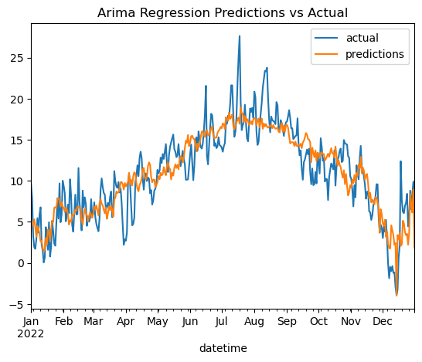
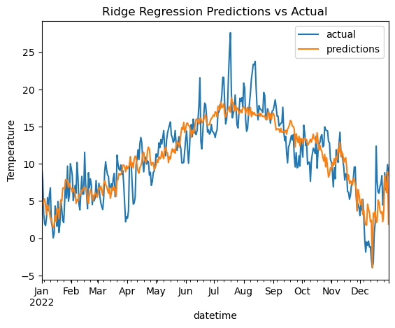

Slide 16
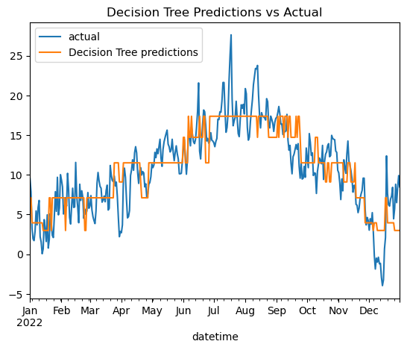

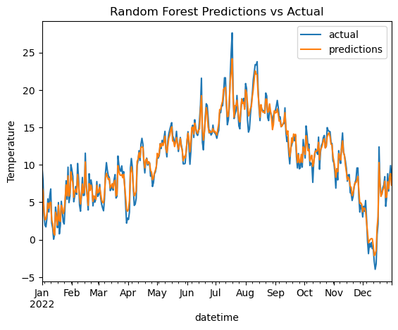

Slide 17
Testing the model as against 10 days in June
Error Metric | Linear Regression (⁰C) | Rigid Regression (⁰C) | Arima (⁰C) | Random Forest (⁰C) | Decision Tree (⁰C)
Mean Absolute Error (MAE) | 4.32 | 5.89 | 4.80 | 3.42 | 3.81
Mean Squared Error (MSE) | 27.20 | 39.29 | 36.40 | 20.20 | 23.64
Root mean Squared Error (RMSE) | 5.22 | 6.26 | 6.03 | 4.50 | 4.86

Slide 18
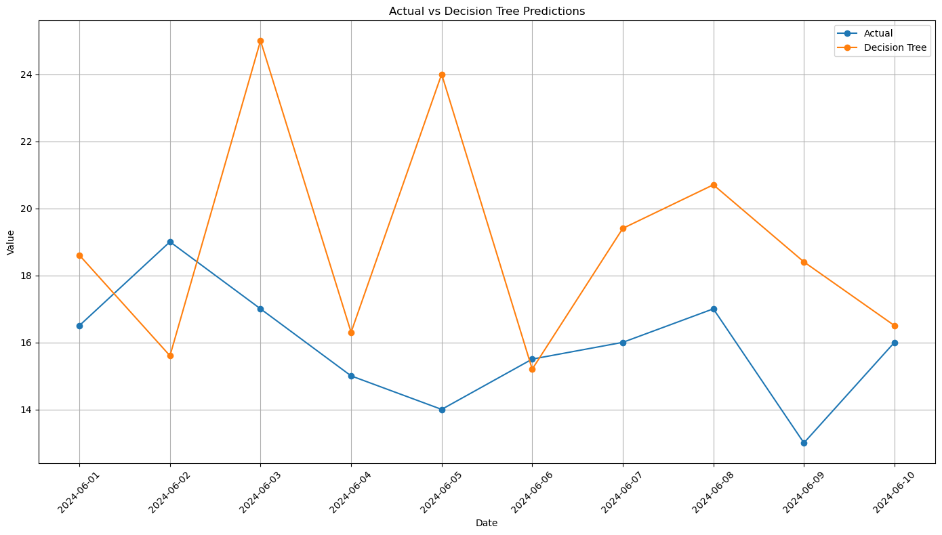
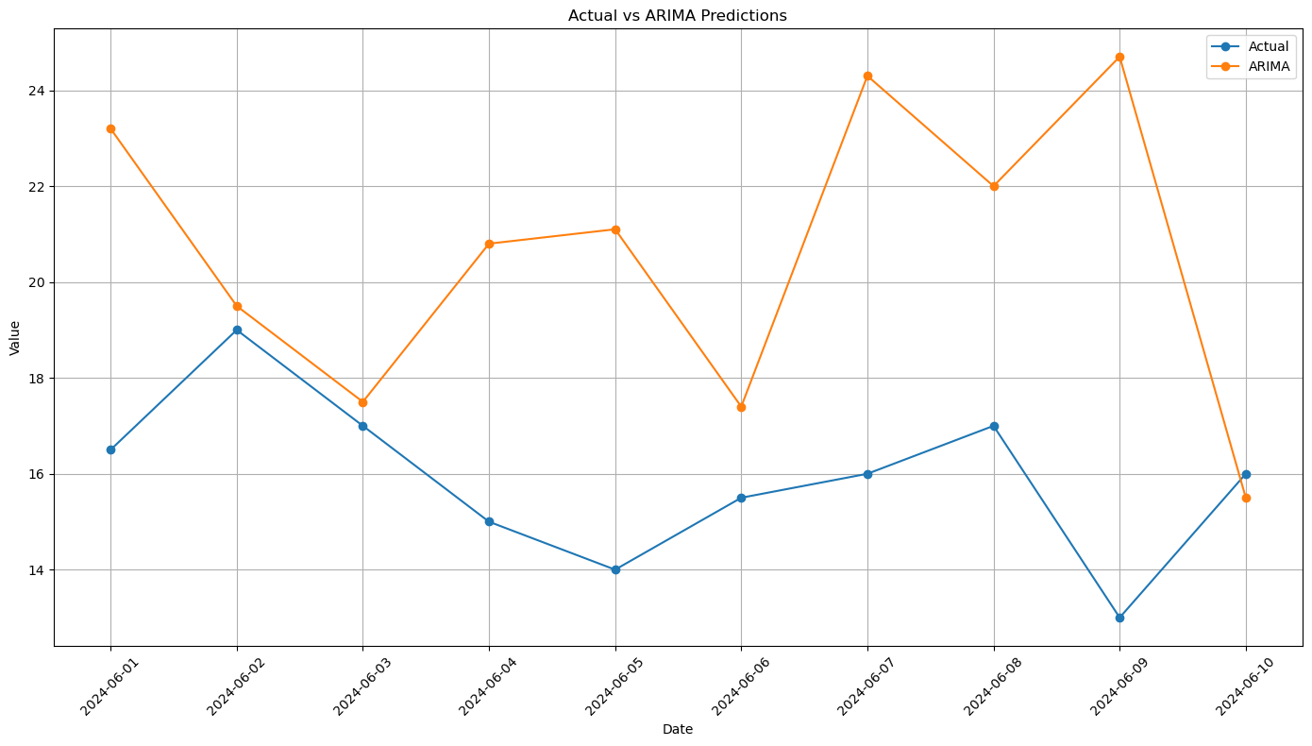

Slide 19
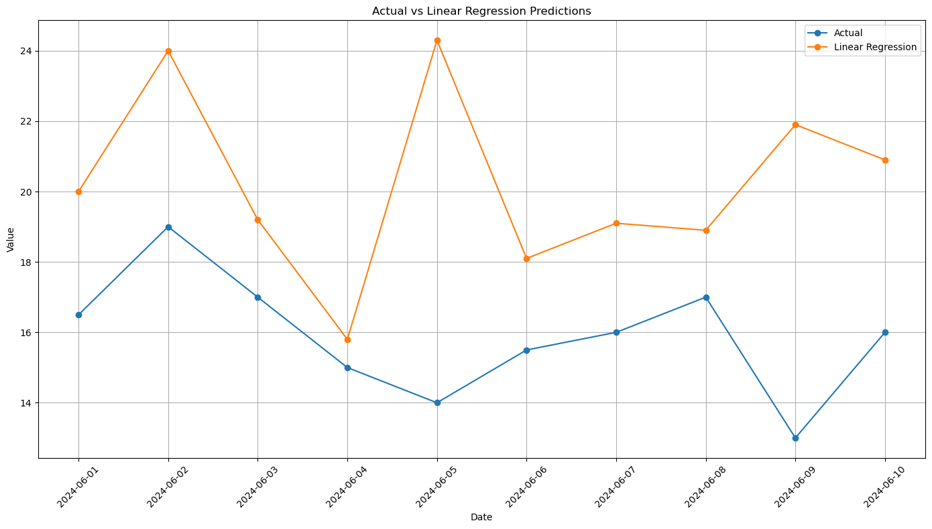
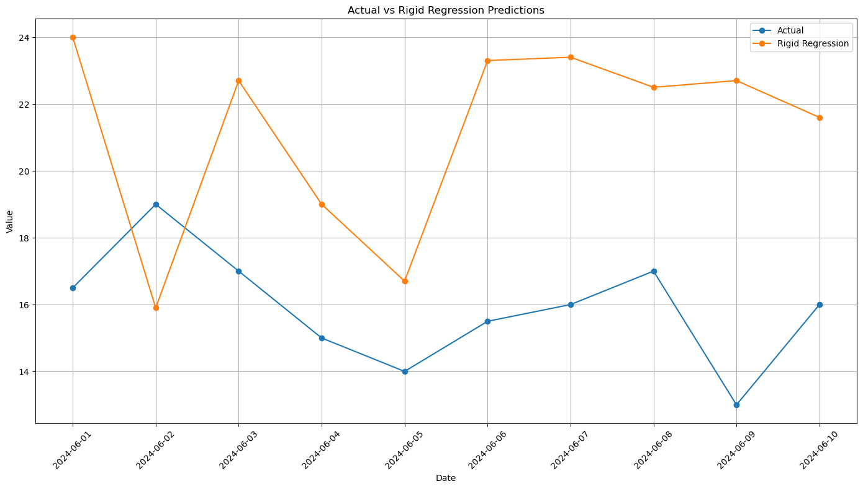

Slide 20
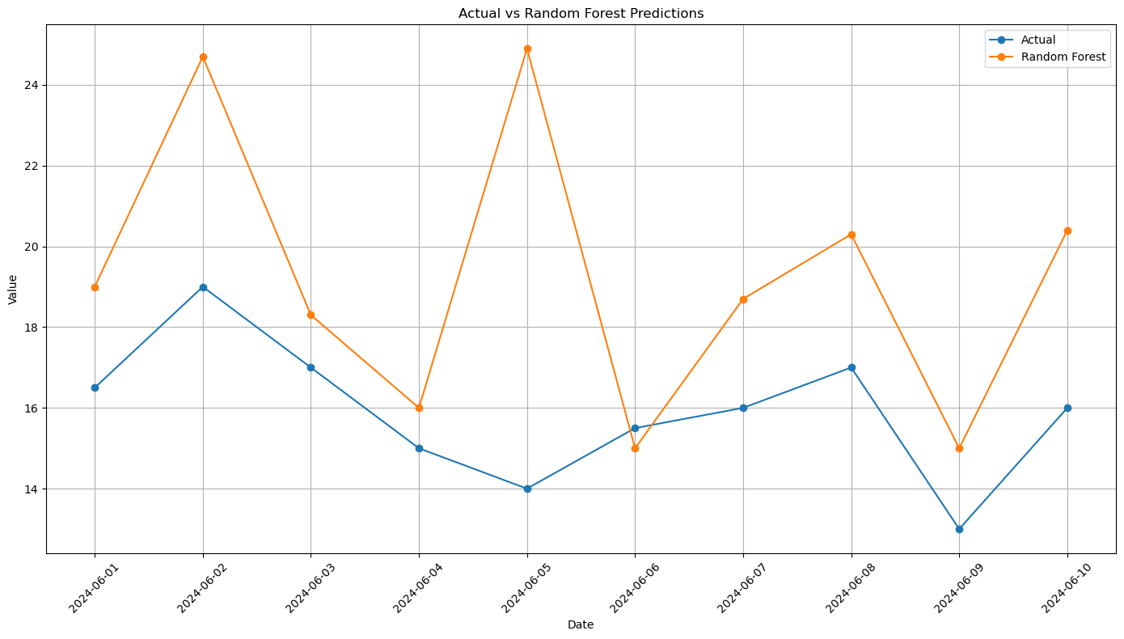

Slide 21

Conclusion
The Random Forest model achieved the lowest Mean Absolute Error (MAE) and Root Mean Squared Error (RMSE), as well as a high R² score, indicating its robustness and reliability. The Decision Tree model also performed well, though slightly less accurately than Random Forest.
ARIMA, a traditional time series forecasting method, did not perform as well as the machine learning models. This suggests that the complex and non-linear nature of weather data might be better captured by machine learning models. Linear Regression and Ridge Regression demonstrated moderate accuracy

Slide 22
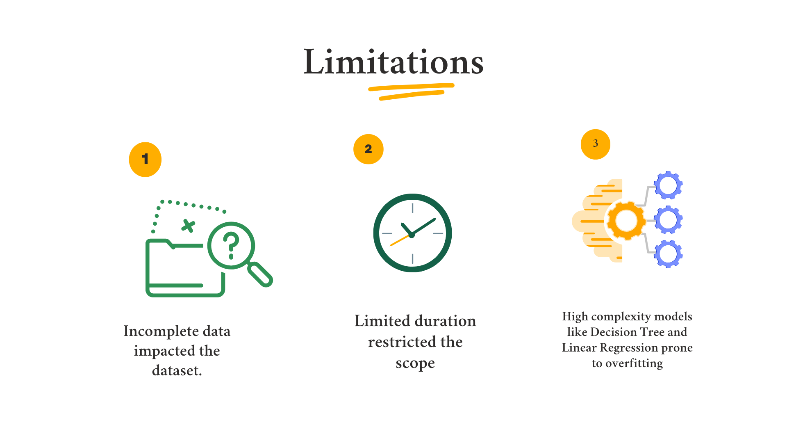

Slide 23
REFERENCES

Slide 24
Aggarwal, R. and Ranganathan, P. (2019) ‘Study designs: Part 2 - Descriptive studies’, Perspect Clin Res, 10(1), pp. 34-36.
Alley, R. Zhang, F. and Emanuel, K. (2019) ‘Advances in Weather Prediction’, Science, 363(6425), pp. 342-344. DOI:10.1126/science.aav7274
Asenahabi, B. (2019) ‘Basics of Research Design: A Guide to selecting appropriate research design’, International Journal of Contemporary Applied Researches, 6(5), p.78
Ayodele, P. and Precious, E. (2019) ‘Seasonal rainfall prediction in Lagos, Nigeria using artificial neural network’, Asian Journal of Research in Computer Science, 3(4), pp. 1–10.
Balehegn, M. Balehey, S. and Fu, C. (2019) ‘Indigenous weather and climate forecasting knowledge among Afar pastoralists of north eastern Ethiopia: Role in adaptation to weather and climate variability’, Pastoralism 9(8)
Bryman, A. (2016). Social research methods. Oxford University Press.
Chen, L. Han, B. Wang, X. Zhao, J. Yang, W. and Yang, Z. (2023) ‘Machine Learning Methods in Weather and Climate Applications: A Survey’, Applied Sciences, 13(21), 12019. https://doi.org/10.3390/app132112019
Chen, X. Yang, T. Wang, Z. Wang, F. and Wang, H. (2023) ‘An ensemble method for improving the estimation of planetary boundary layer height from radiosonde data’, Atmos. Meas. Tech. Discuss. 16(1), pp. 4289–4302

Slide 25
Demir, V. and Citakoglu, H. (2023) ‘Forecasting of solar radiation using different machine learning approaches’, Neural Computing and Applications, 35(1), pp.887–906.
Ghanad, A. (2023) ‘An Overview of Quantitative Research Methods’, International Journal of Multidisciplinary Research, 6(8), pp. 3794-3803.
Hanlon, M. Bernie, D. and Carigi, G. (2021) Future changes to high impact weather in the UK. Climatic Change 166(1), p.50.
Kushnir, Y. and Stein, M. (2019) ‘Medieval Climate in the Eastern Mediterranean: Instability and Evidence of Solar Forcing’, Atmosphere. 10(1), p. 29.
Lappin, M. Bell, M. Pillar-Little, A. and Chilson, B. (2022) ‘Low-level buoyancy as a tool to understand boundary layer transitions’, Atmos. Meas. Tech. Discuss, 15(1), pp.1185–1200
Mashao, M. Demoz, B. Kifle, Y. Klopper, D. Chikoore, H. Sakai, K. and Ayisi, K. (2024) ‘An Appraisal of the Progress in Utilizing Radiosondes and Satellites for Monitoring Upper Air Temperature Profiles’, Atmosphere, 15(1), p.387.
Nichols, A. Chan, H. and Baker, B. (2019) ‘Machine learning: applications of artificial intelligence to imaging and diagnosis’, Biophys Rev, 11(1), pp.111-118.
Oztemel, E. and Gursev, S. (2020) ‘Literature review of Industry 4.0 and related technologies’, J. Intell. Manuf, 31(1), pp.127–182.

Slide 26
Parker, J. Blyth, M. Woolnough, J., Dougill, J. Bain, C. and de Coning, E. (2021) ‘The African SWIFT project: Growing science capability to bring about a revolution in weather prediction’, Bull. Am. Meteorological Soc, 103(2), pp.349–369
Santos, N. (2023) ‘The Expansion of Data Science: Dataset Standardization’, Standards, 3(4), pp.400-410. https://doi.org/10.3390/standards3040028
Petropoulos, F. Apiletti, D. and Assimakopoulos, V. (2022) ‘Forecasting: theory and practice’, International Journal of Forecasting. https://doi.org/10.1016/j.ijforecast.2021.11.001
Python Software Foundation. Python Language Reference, version 3.10. Available at https://www.python.org.
R Core Team (2024). R: A language and environment for statistical computing. R Foundation for Statistical Computing, Vienna, Austria. URL https://www.R-project.org/.
Resnik, B. (2022) ‘Philosophical Foundations of Human Research Ethics’, Perspect Biol Med, 65(3), 499e513.
Santosh, K. Das, N. and Ghosh, S. (2021) Deep Learning Models for Medical Imaging: A Volume in Primers in Biomedical Imaging Devices and Systems. Elsevier.
Sarker, H. Hoque, M. and Tawfeeq, A. (2020) ‘Mobile data science and intelligent apps: concepts, ai-based modeling and research directions’, Mob Netw Appl, pp.1–19.
Sarker, H. Kayes, M. Badsha, S. Alqahtani, H. Watters, P. and Ng, A. (2020) ‘Cybersecurity data science: an overview from machine learning perspective’, J Big Data,7(1), pp.1–29.
Sarker, H. (2021) ‘Machine Learning: Algorithms, Real-World Applications and Research Directions’, Sn Comput. Sci. 2(1), p.160.
Tuval-Mashiach, R. (2017) ‘Raising the curtain: The importance of transparency in qualitative research’, Qualitative Psychology, 4(2), pp.126–138. https://doi.org/10.1037/qup0000062

Slide 27
Visual Crossing (2024) Total Weather Data: Historical Weather Data & Weather Forecast Data. Retrieved at https://www.visualcrossing.com/weather-data Accessed July 3 2024
Wakefield, K (2024) A guide to the types of machine learning algorithms and their applications. [Online] Available at: https://www.sas.com/en_gb/insights/articles/analytics/machine-learning-algorithms.html#:~:text=There%20are%20four%20types%20of,%2Dsupervised%2C%20unsupervised%20and%20reinforcement. (Assessed: June 19, 2024).
Wang, Y. Shaw, E. Kruse, B. and Ghods, M. (2018) ‘On identifying factors affecting ethical practices in data science domains’, SMU Data Science Review, 1(2), p. 2.
Xu, Z. Li, Y. Guo, Q. Shi, X. and Zhu, Y. (2020) ‘A Multi-Model Deep Learning Ensemble Method for Rainfall Prediction’, J. Hydrol, 584, 124579.
Zhou, Q. Zhang, Y. Jia, S. Jin, J. Lv, S. and Li, Y. (2020) ‘Climatology of cloud vertical structures from long-term high-resolution radiosonde measurements in Beijing’, Atmosphere, 11(1), p.401.

